Slide 1
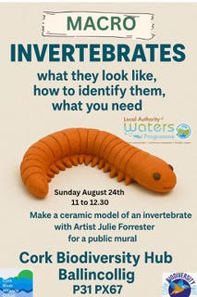
Macro invertebrates – What they look like and how to identify them

Slide 2
What does Macro mean?
Macro vs Micro

Slide 3
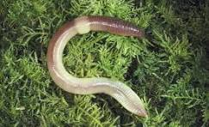

What is an invertebrate animal?
An invertebrate has no backbone.
A vertebrate has a backbone.

Slide 4
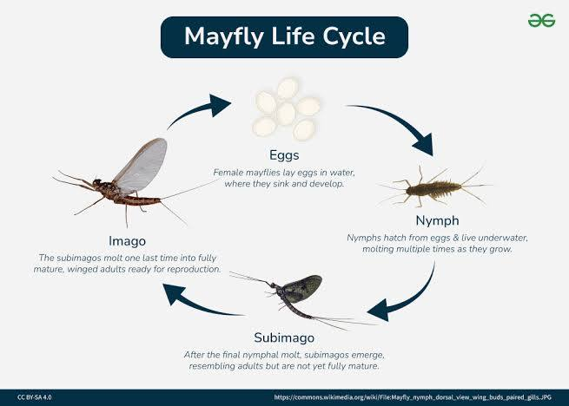
Why are macro invertebrates important?
Macro invertebrates go through a long life cycle from egg to nymph to adult. Nymph and adult stages can be seen by the naked eye.

Slide 5
Why are macro invertebrates important?
They help indicate water quality as some species tolerate only good quality water, while others tolerate moderate or poor water quality.

Slide 6
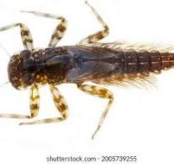
Identifying Macro Invertebrates
Use a magnifying glass to identify features of different species.
Citizen scientists use key species to determine if rivers are good, moderate, or poor.

Slide 7
Identifying Macro Invertebrates
There is a huge range of macro invertebrates that have adapted to live in river water, however some can only tolerate good quality water, other will tolerate moderate and poor quality water. For this reason specific species have been identified that can be used by citizen scientists and those who monitor water quality to tell if the river can be good, moderate or poor.

Slide 8
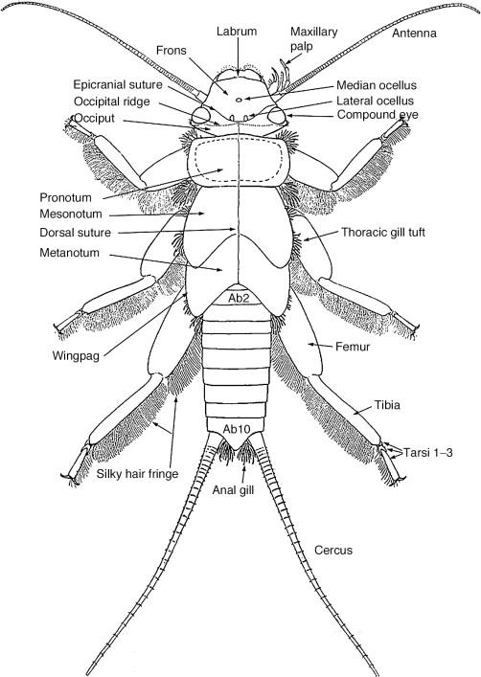
Stonefly Diagram
A stonefly is like an underwater earwig without the pincers and has 2 tails.

Slide 9
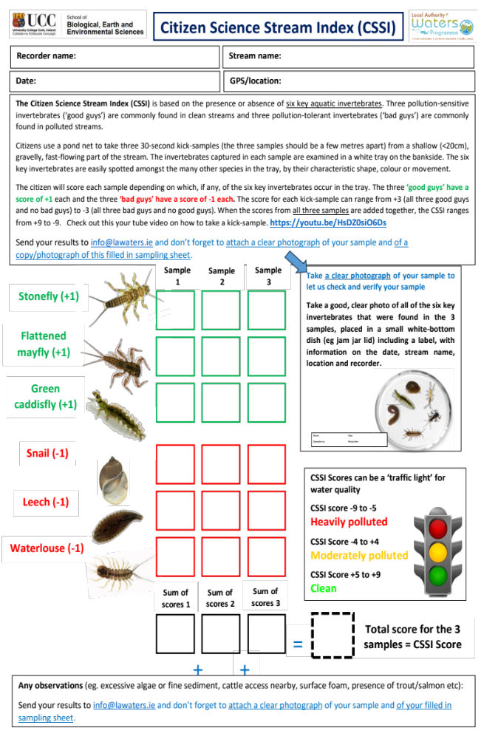
CCSI

Slide 10
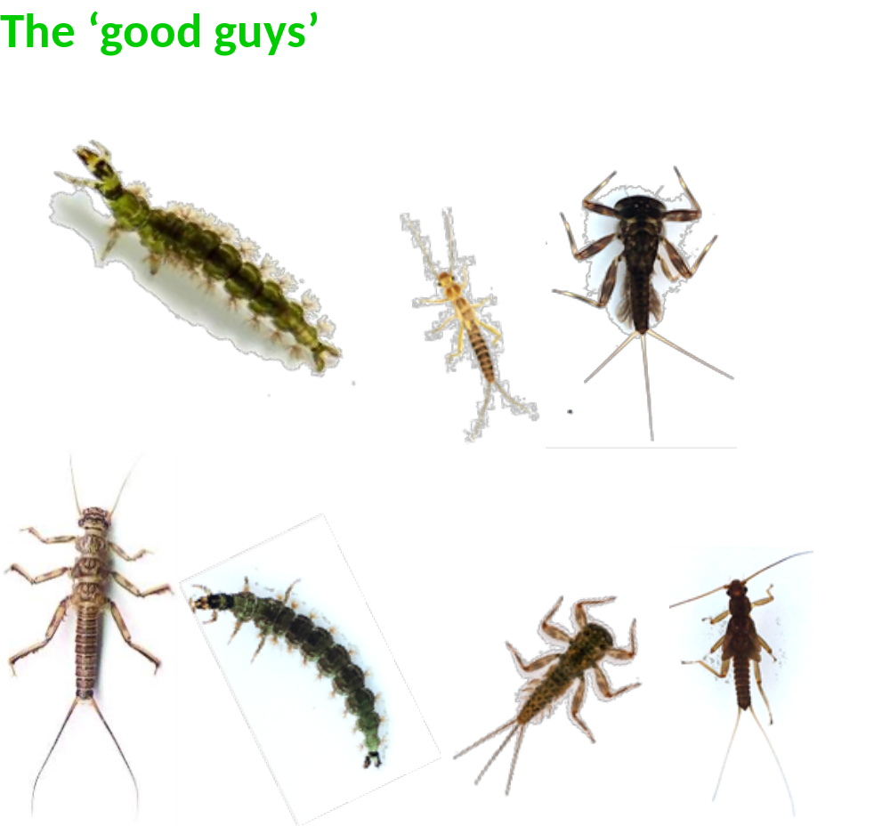
Examples of ‘Good Guys’

Slide 11
Examples of ‘Good Guys’
Green Caddisfly – green caterpillar-like larva with gills
Stonefly – 2 thin tails at end of abdomen
Flattened Mayfly – 3 thin tails, wide head, large eyes, flattened body

Slide 12
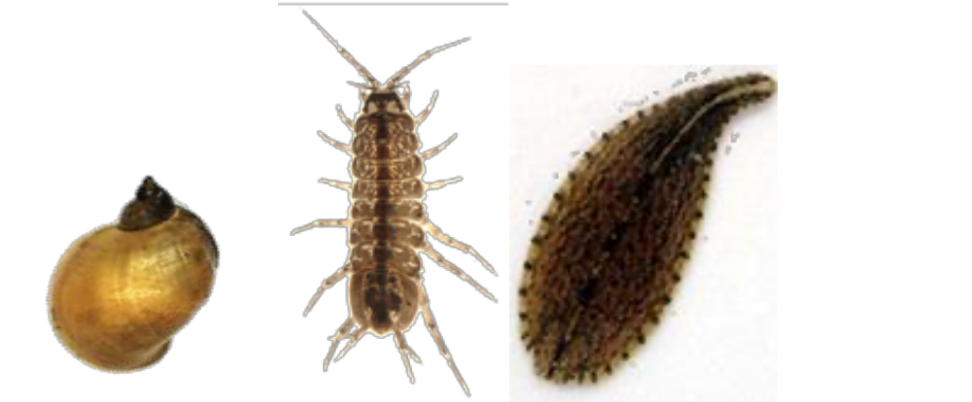
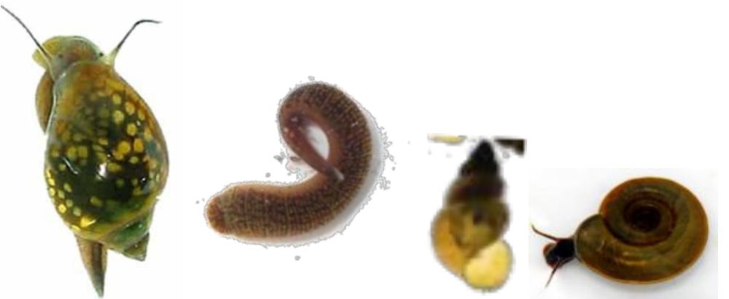
Examples of ‘Bad Guys’

Slide 13
Examples of ‘Bad Guys’
Snail – hard shell
Waterlouse – looks like woodlouse, crawls slowly
Leech – suckers at both ends, moves by stretching

Slide 14
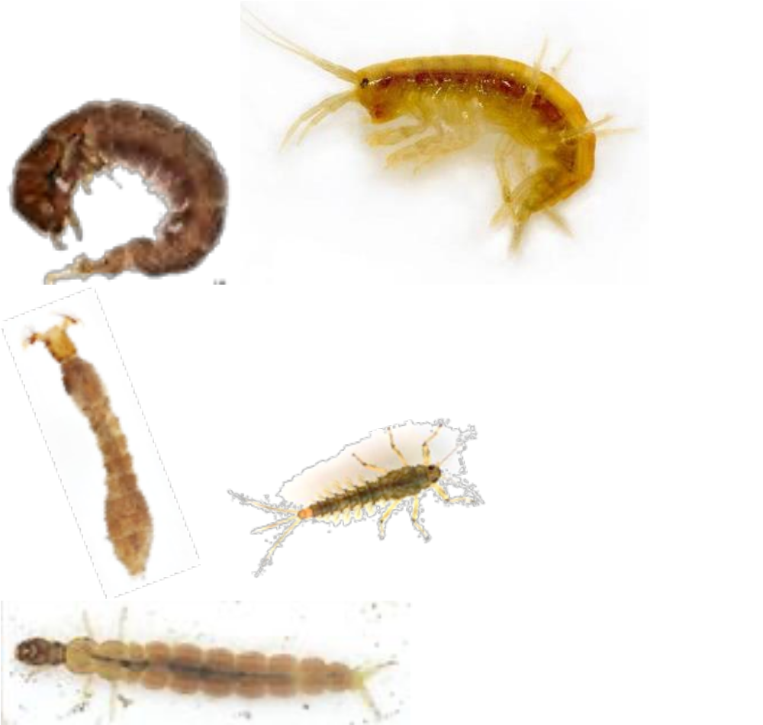
Other Common Invertebrates (not scored for CSSI)
Freshwater shrimp
Swimming mayfly
Blackfly larva
Brown caddisfly
Pink caddisfly

Slide 15
Kick Sampling
Method used to collect samples in rivers.
Safety guidelines:
Plan in advance
Get landowner permission
Wear life jacket
Ensure biosecurity (clean equipment/waders)
Work in pairs and inform others of location and time
Notes:
To collect the samples in previously identified areas a method called kick sampling is used.
This must be planned in advance, as any results collected will only be useful if a scientific method is strictly adhered to.

Slide 16
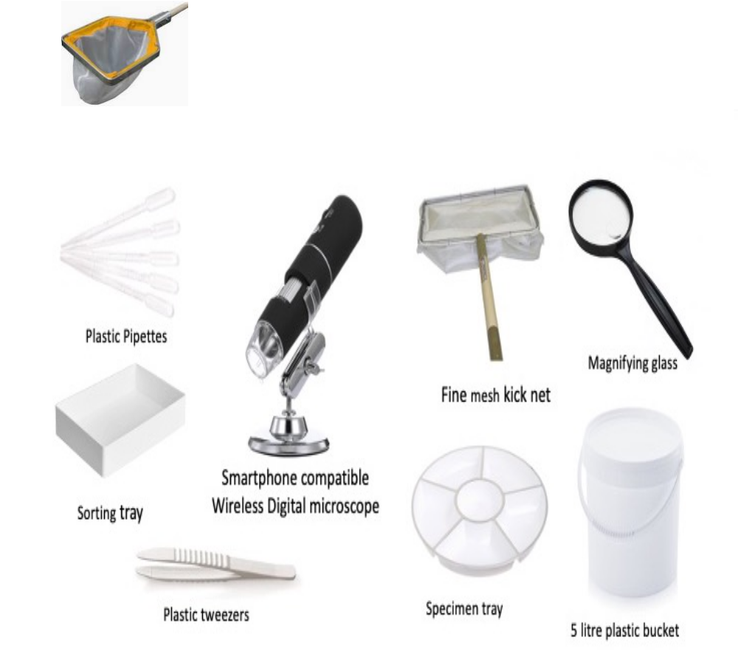
Kick Sampling Equipment

Slide 17
Kick Sampling Equipment
Camera for photos and location recording (longitude and latitude)
CSSI form and pen (for LAWPRO)
White tray and containers
Net for collection

Slide 18
Kick Sampling Method
Person A:
Collects water in tray/containers
Records location & notes
Helps transfer invertebrates
Records good/bad guys and calculates water quality score
Person B:
Enters stream facing downstream, places net on streambed
Disturbs stones/silt to dislodge invertebrates
Empties contents into tray
Repeat process 3 times at each site

Slide 19
Further Learning (Videos)
YouTube links:
https://www.google.com/url?sa=t&source=web&rct=j&opi=89978449&url=https://www.youtube.com/watch%3Fv%3DyoFK4hCu42c&ved=2ahUKEwi9hO6x9paPAxW-S0EAHfCyDycQ9KsOegQIFhAB&usg=AOvVaw2oOH1XJKSS9fM1jdi81wxJ
https://www.google.com/url?sa=t&source=web&rct=j&opi=89978449&url=https://www.youtube.com/watch%3Fv%3D3vUoFqvnO-Y&ved=2ahUKEwi9hO6x9paPAxW-S0EAHfCyDycQ9KsOegQIFxAB&usg=AOvVaw0vKFR0khd9Mt71YmR6JXyW
https://www.google.com/url?sa=t&source=web&rct=j&opi=89978449&url=https://www.youtube.com/watch%3Fv%3DpAFsz_tmyx8&ved=2ahUKEwi9hO6x9paPAxW-S0EAHfCyDycQ9KsOegQIGBAB&usg=AOvVaw1FFQBu7g8BVqtZzAlmCH6I

